Slide 1
Core Components
Competency Accuracy
Communication

Slide 2
Five Ways To Assess Service
Empathy
Reliability
Assurance
Responsiveness
Tangibles

Slide 3

Picture Before

Slide 4

Picture After….

Slide 5
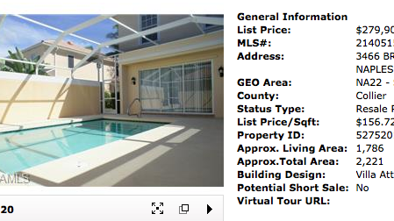


Slide 6

Timely Communication

Slide 7

How does your client want to communicate with you?

Slide 8


Necessities in Communication
Conversation
Listening
Correspondence

Slide 9
Take a Tip from Marriott
89% of guests with no problems ….we’ll be back
69% of guests with problems not resolved…we’ll be back
94% of guests with problems that were resolved…we’ll be back

Slide 10

Pathways To Professionalism
Order on line at
REALTOR.org and give to all of your buyers and sellers.

Slide 12
“True ethics means
holding yourself to the highest
level of behavior
because you want to—
not because you’re
afraid of getting caught and
punished for flouting
a specific rule.”
~Peggy and Peter Post
The Etiquette Advantage in Business

Slide 13
Article 1
When representing a buyer, seller, landlord, tenant, or other client as an agent, Realtors® pledge themselves to protect and promote the interests of their client. This obligation to the client is primary, but it does not relieve Realtors® of their obligation to treat all parties honestly. When serving a buyer, seller, landlord, tenant or other party in a non-agency capacity, Realtors® remain obligated to treat all parties honestly. (Amended 1/01)

Slide 14
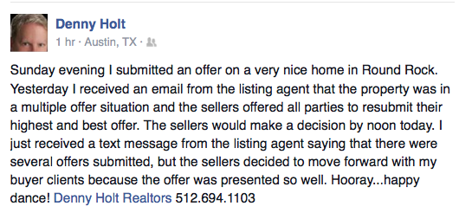

Slide 15
Article 3
REALTORS® shall cooperate with other brokers except when cooperation is NOT in the client’s best interest. The obligation to cooperate does not include the obligation to share commissions, fees, or to otherwise compensate another broker.
SOP 3-10: The duty above relates to the obligation to share information on listed property and to make property available to other brokers for showing to prospective purchasers/tenants when it is in the best interest of the sellers/landlords.

Slide 16
Article 9
Realtors®, for the protection of all parties, shall assure whenever possible that all agreements related to real estate transactions including, but not limited to, listing and representation agreements, purchase contracts, and leases are in writing in clear and understandable language expressing the specific terms, conditions, obligations and commitments of the parties. A copy of each agreement shall be furnished to each party to such agreements upon their signing or initialing. (Amended 1/04)

Slide 17
Article 10
REALTOR(S) shall not deny equal professional services to any person for reasons of race, color, religion, sex, handicap, familial status, national origin, sexual orientation. Or gender identity. REALTORS® shall not be parties to any plan or agreement to discriminate against a person or persons on the basis of race, color, religion, sex, handicap, familial status, national origin, sexual orientation or gender identity.

Slide 18
Article 12
Realtors® shall be honest and truthful in their real estate communications and shall present a true picture in their advertising, marketing, and other representations. Realtors® shall ensure that their status as real estate professionals is readily apparent in their advertising, marketing, and other representations, and that the recipients of all real estate communications are, or have been, notified that those communications are from a real estate professional. (Amended 1/08)

Slide 19
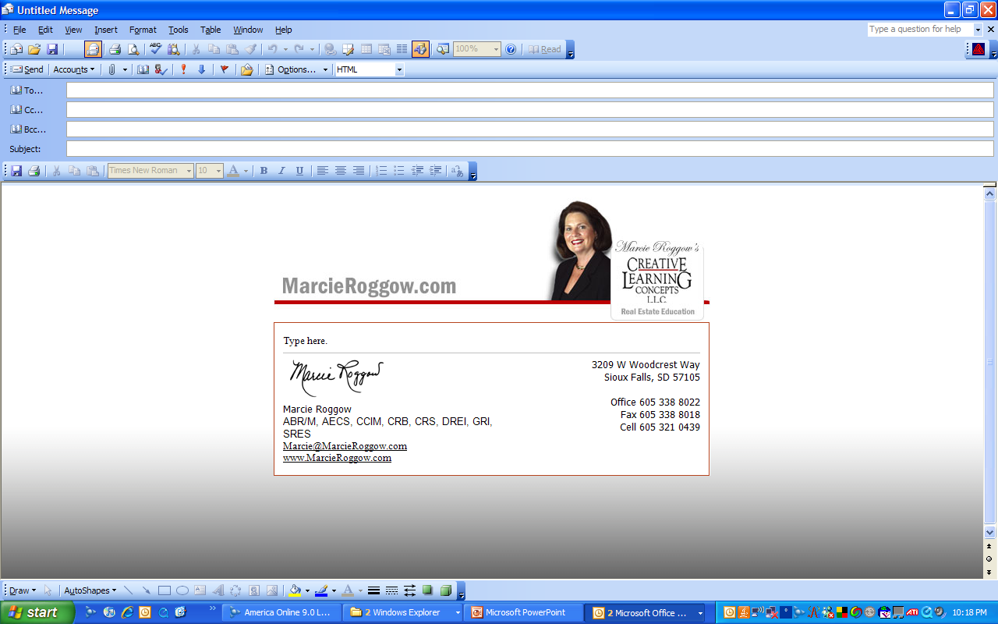

Slide 20
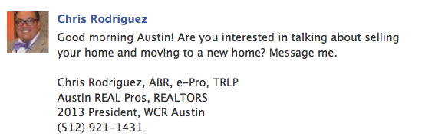
Inducing for business:

Slide 21
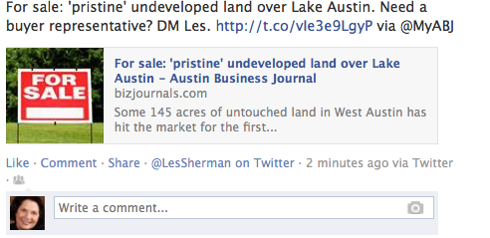


Slide 22
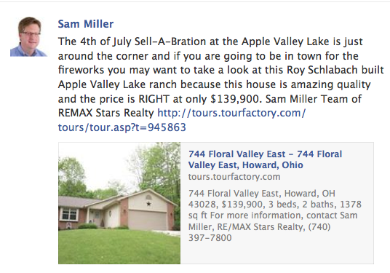

Slide 23



The fore fathers never dreamed…
SOP:12-8
“Obligation to present a true picture!”
Notes:
I remember a year ago we were sitting in professional standards when we discussed the amazing skill several of our realtor members had obtained through photo shop. Yes..we can change the grass to green. Remove power lines, even take out a dead bush or two…no one will be the wiser…unti they try to go find the house.
Recently there was a case where I was called in for advice. The problem was that the virtual tour of the home showed the draperiers all nicely hung. (mind you there was furniture too) but when the buyers LOOKED at the house the furniture and the draperies were gone. Yet before they closed they insisted that the drperies were returned….even though they were not included in the purchase contract. So presenting a true picture can take on many forms. The discussion about what could be changed in a picture and what couldn’t be I must admit did get me chuckling….(snow story)

Slide 24
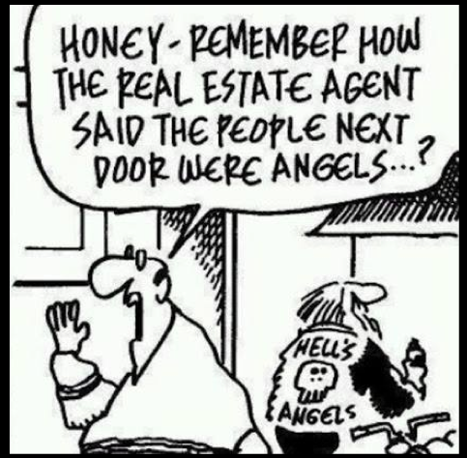

Slide 25
SOP 12-13
The obligation to present a true picture in advertising, marketing, and representations allows REALTORS® to use and display only professional designations, certifications, and other credentials to which they are legitimately entitled. (Adopted 1/08)
Marcie Roggow
ABR/M, CCIM, CRB, CRS, DREI, SRS
Notes:
The CCIM (Council of Commercial Investment Members) last May brought to Pro Standards a cause of action. Like all of the NAR designations they were experiencing members using the designation but NOT having paid their dues. At CRS we used to talk about sending someone in to ‘rip the plaque off the wall of the non paying member. But the CCIMs were able to bring forth this SOP and now for all of you who monitor the use of designations is the answer to your prqyers…its one way to meet the members of the professional staandards committee quickly.

Slide 26

Confidentiality you say?
Xxxxxxx(agent’s name) 5 showings today on my brand new listing. It was priced right. At least one offer is coming in and it's full price, no concessions. I posted it earlier today on FB, Twitter, MySpace, and all the usual suspects.
Now, keeping in mind that tweets could be entered as evidence in court, consider this tweet (I've removed the name from this one):
Notes:
Whoa. As a broker-owner, I'd have grave concerns about one of my agents tweeting this. Chances are, and we hope, this single tweet will not affect the outcome of the home sale for this Twit's client but boy you can imagine numerous scenarios where it could and would affect the outcome. Imagine I'm a buyer considering writing an offer just $30K below asking. Well heck, I don't want to overpay for the property. If someone else was offering so much less, maybe it's not worth what I thought it was. Maybe I should write an offer for $80K under asking.
Is this kind of disclosure a breach of fiduciary duties to the seller clients? As professional real estate agents, shouldn't we be maintaining confidentiality about ongoing negotiations? Like other electronic communication such as email, once you hit 'enter' your tweets are out in the public domain, indelible (yes tweets create a permanent record on the internet which you CANNOT delete), and discoverable by a court of law. The National Law Journal has a great article entitled, "Beware: Your 'tweet' on Twitter could be trouble".
Perhaps tweets will not cause you to be involved in a lawsuit. They may still cost you clients. Check out this tweet (again I removed the name but in fact anybody can find these posts by searching twitter):

Slide 27

Great ad….right?

Slide 28



You be the judge….

Slide 29
Article 15
REALTORS® shall not knowingly or recklessly make false or misleading statements about other real estate professionals, their businesses, or their business practices.
SOP 15-1 REALTORS® shall not knowingly or recklessly file false or unfounded ethics complaints

Slide 30
Article 16
Realtors® shall not engage in any practice or take any action inconsistent with exclusive representation or exclusive brokerage relationship agreements that other Realtors® have with clients. (Amended 1/04)

Slide 31
“Diplomacy is an excellent approach to helping any situation that involves behavioral issues. Avoid using blaming words… focus on being helpful instead of harmful. It is not necessarily what you say, but what words you choose to say it with when dealing with a difficult situation.”
~Gloria Peterson

Slide 32


Handling Criticism

Slide 33

How Does the public see you?

Slide 34
…AND ANSWER QUESTIONS ON TRULIA VOICES
“As for the MLS or discount brokers, sometime it does appear on the MLS but 1) that broker only wants to list your house to get buyer leads so he can sell them other homes that aren’t overpriced. 2) Me being a realtor, I know which brokers are discount brokers and I never show there homes. If I bring an offer and then the owner gets a little lower offer he will take that one because he is FSBO and doesn’t have to pay commission so I wasted my time showing that home and not get paid. 3) If I show it and the buyers go directly to the owner then im out of commission so I steer them away from those properties. Do it right the first time and hire a qualified realtor rather then waste your money GOOD LUCK!!!!”

Slide 35

“Packaging Yourself:
Dressing for Business”
By June Hines Moore

Slide 36
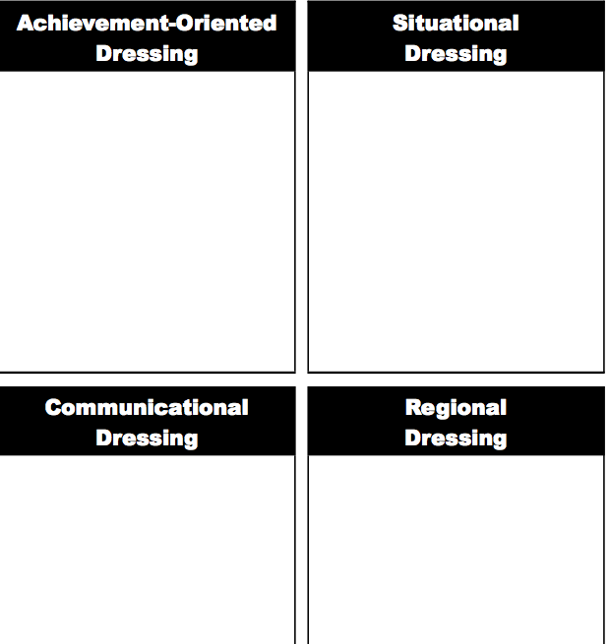

Slide 37

Behavior Never Lies
Trust that has been cracked can be repaired, but not rebuilt to its original condition. The contradiction between what is said and what is done will destroy one’s respect for another. Trust is only solid when the spoken word and behavior are in sync.

Slide 38
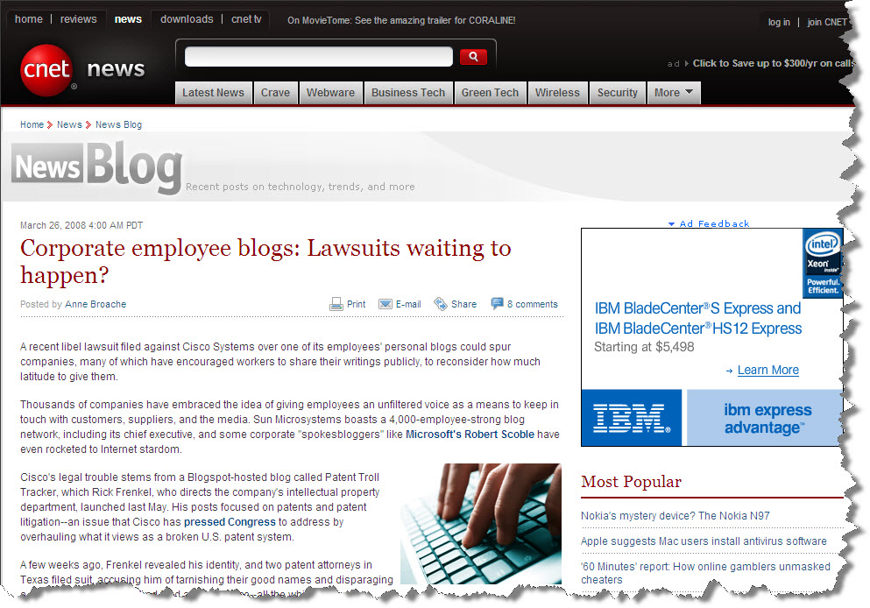
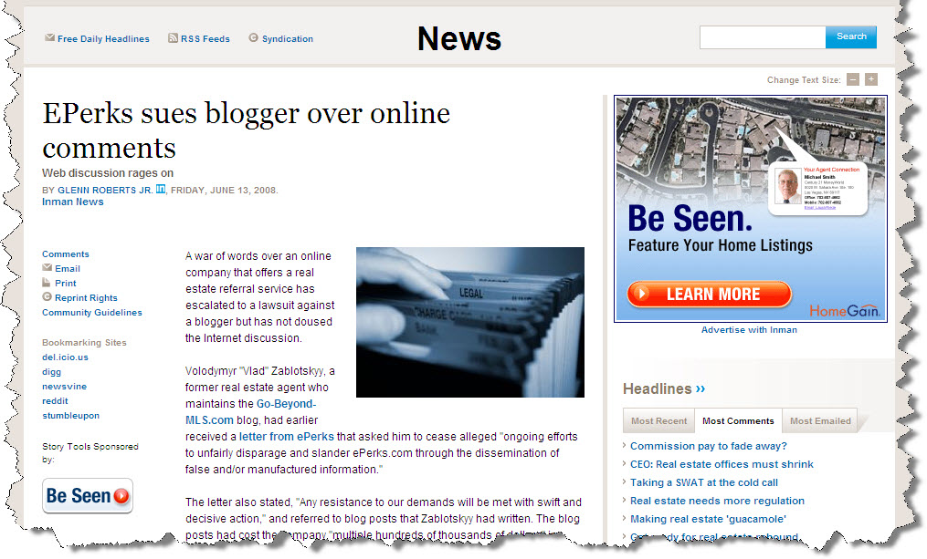
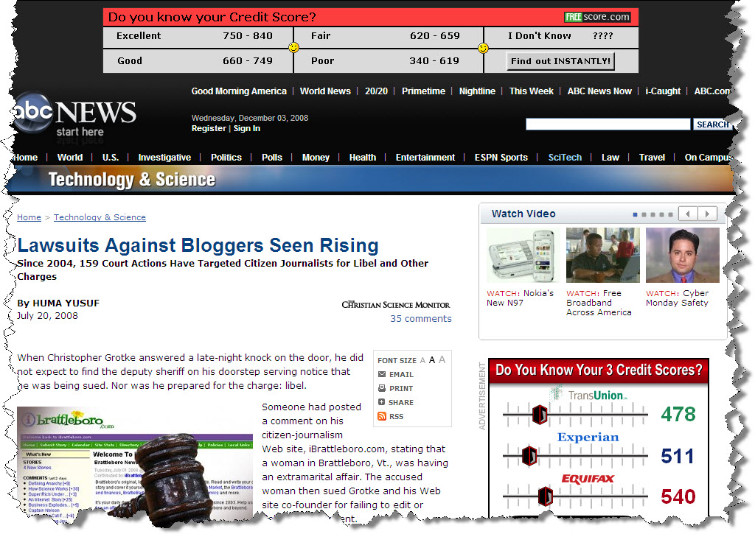
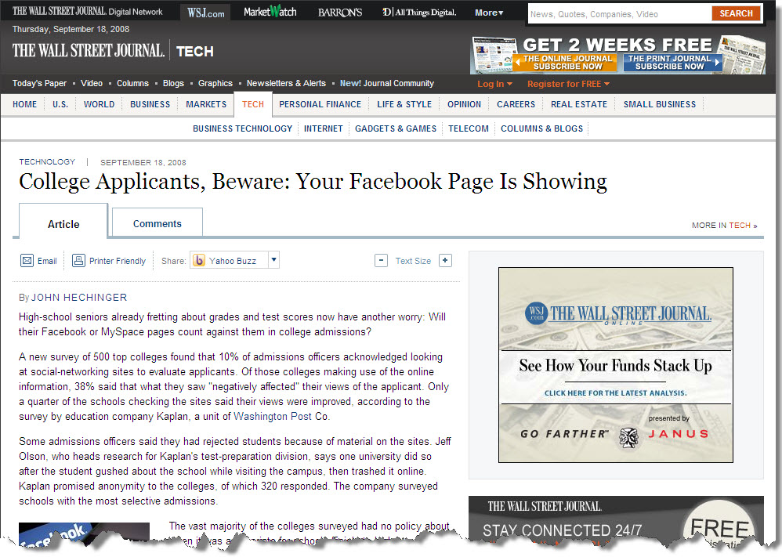
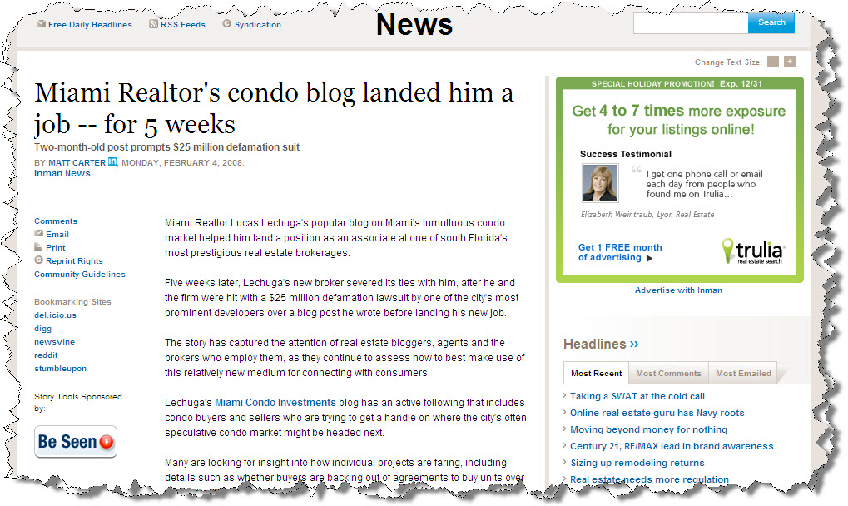
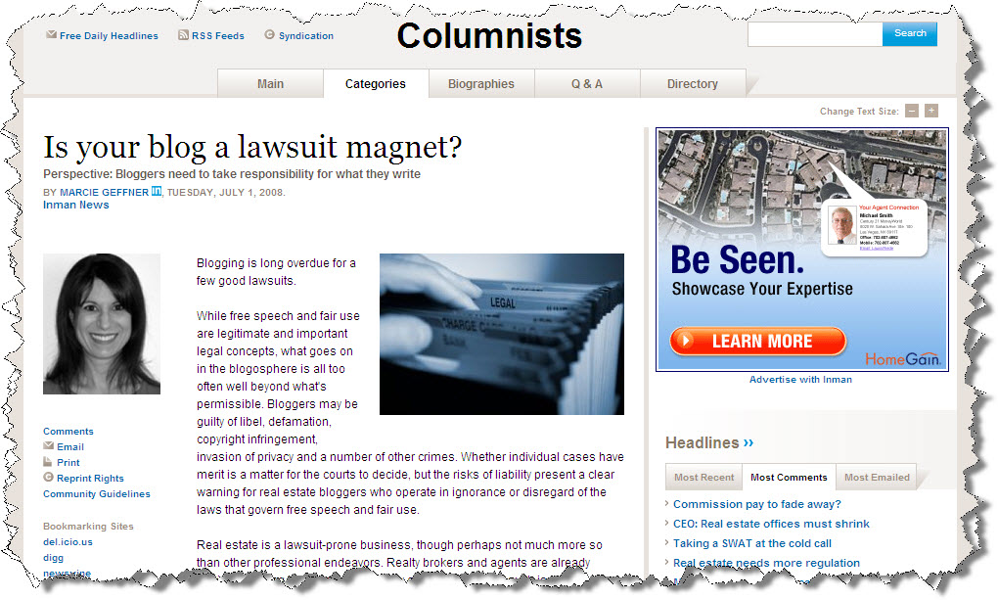
What Are the Odds?
Notes:
Blogging became a fast hit with realtors. It was a way to promote a city, a neighborhood, yourself…how and when to buy…when to sell…market conditions, etc! Well the probably with blogging is that it is normally ‘your opinion’…so when that opinion turns out to be wrong, then what you have is the potential for a lawsuit and shown by thiese articles.

Slide 39
Engaged customers “can’t imagine a world without The Ritz-Carlton”.
How about YOUR customers/clients?

